Slide 1
Re-engineering TIBCO BW5x Code Using GenAI Model
Extracting Documentation and Diagrams for Developer Efficiency
Name: Prashant Bhaskar Gharat
Date: 02/21/2025

Slide 2
Introduction
Overview of re-engineering TIBCO BW5 code
Brief mention of extracting documentation and diagrams
Importance for developers

Slide 3
Client Challenge
Client: Large portfolio of TIBCO BusinessWorks applications (50+)
Situation: Maintenance responsibilities shifting to a new team
Key Challenges:
No formal documentation exists for the applications
Limited knowledge transfer from the original development team
Need to understand complex business logic and technical implementations
Requirement to maintain continuity in day-to-day operations and bug fixes
Need to support future enhancements while preserving existing functionality

Slide 4
Current Knowledge Transition Challenges
Relying on KT sessions from current developers
Incomplete or inconsistent documentation
Managing 100+ applications makes KTs impractical
Manual documentation is time-consuming and resource-intensive

Slide 5
Project Overview
Employee Management Application built in TIBCO BW5x:
Manages employee recruitment, promotion, and separation
Uses three separate databases (employee data, audit logging, error handling)
Features complex process flows and business rules
Check out the GitHub repository: https://github.com/pawas17/TIBCO-BW-5.x-Case-Studies

Slide 6
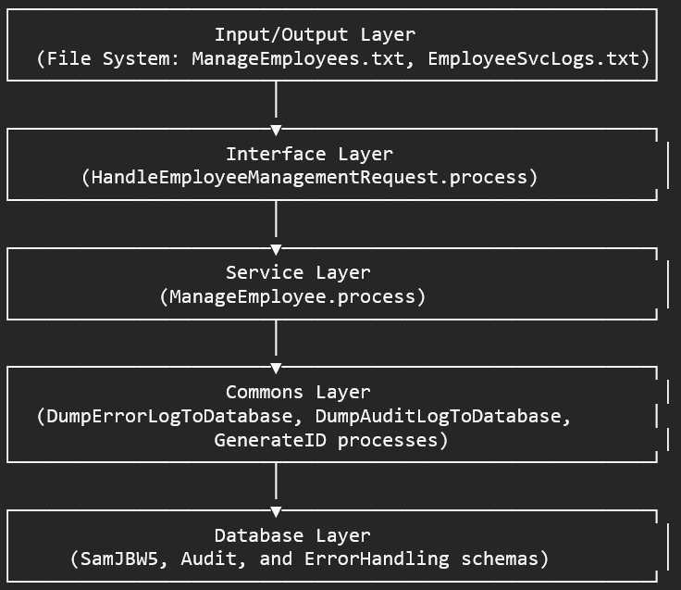
Project Overview
High-Level Architecture:

Slide 7
GenAI Approach
Testing ChatGPT, GitHub Copilot, and Claude
Claude provided the most accurate and structured results with minimal manual intervention
Process involved:
Using prompt engineering techniques
Providing the application code in a structured format
Generating comprehensive documentation and visual artifacts

Slide 8
Deliverables Generated
Documentation:
CaseStudyAutomatedDocumentation.docx
SystemAnalysis.docx
TechnicalDocumentation.docx
Diagrams:
ArchitectureDiagram.png
DeploymentDiagram.png
SequenceDiagram.png
ErrorHandlingSequenceDiagram.png
ReengineeringMethodology.png

Slide 9
Key Findings
Claude efficiently extracts valuable information from TIBCO BW5 code
Reduces documentation time while improving consistency
Some manual verification still required

Slide 10
Benefits for the Client
Knowledge Transfer:
New team understands applications quickly
Reduced ramp-up time
Maintenance Efficiency
Faster issue resolution
Better impact analysis
Lower risk for enhancements
Compliance with audit requirements
Future-Proofing:
Ready for modernization
Assess and manage old technical issues
Continuous improvement

Slide 11
Conclusion
Addressed key challenges
Re-engineered TIBCO BW5 code
Extracted documentation and diagrams
Improved maintenance

